Slide 1
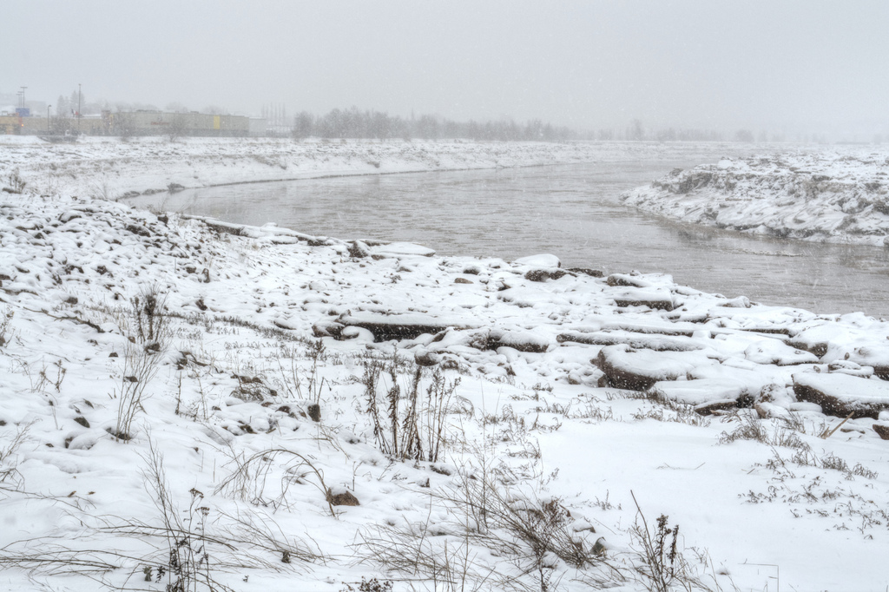
MOOC and OERs
Stephen Downes
06 February 2013

Slide 2
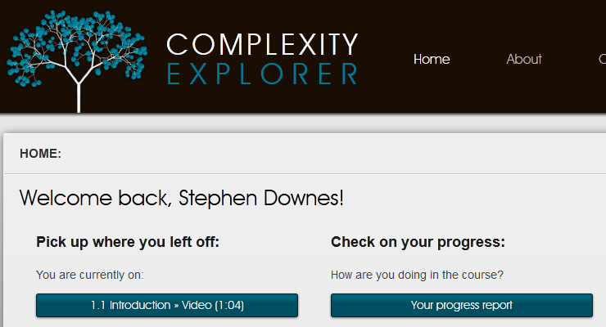
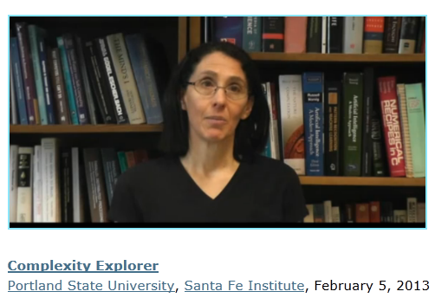
Yesterday
A course about complexity…
http://www.complexityexplorer.org/

Slide 3
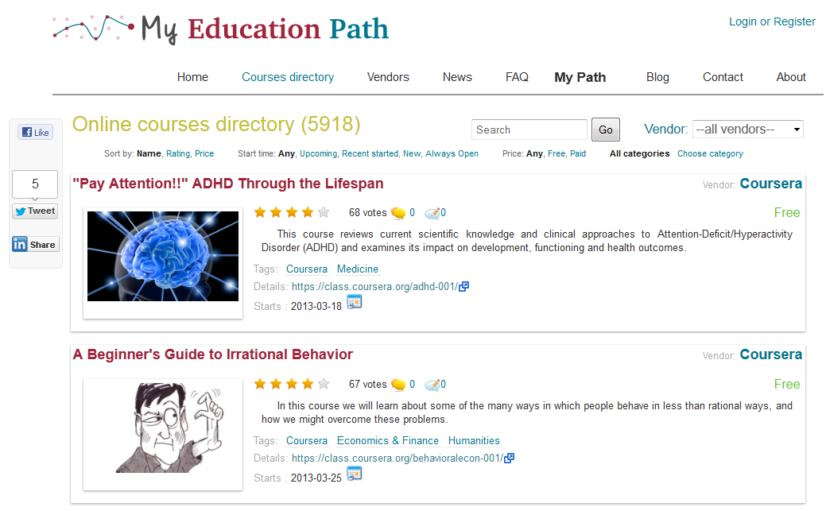
Six Thousand Courses
http://myeducationpath.com/courses
http://www.mooc.ca/

Slide 4
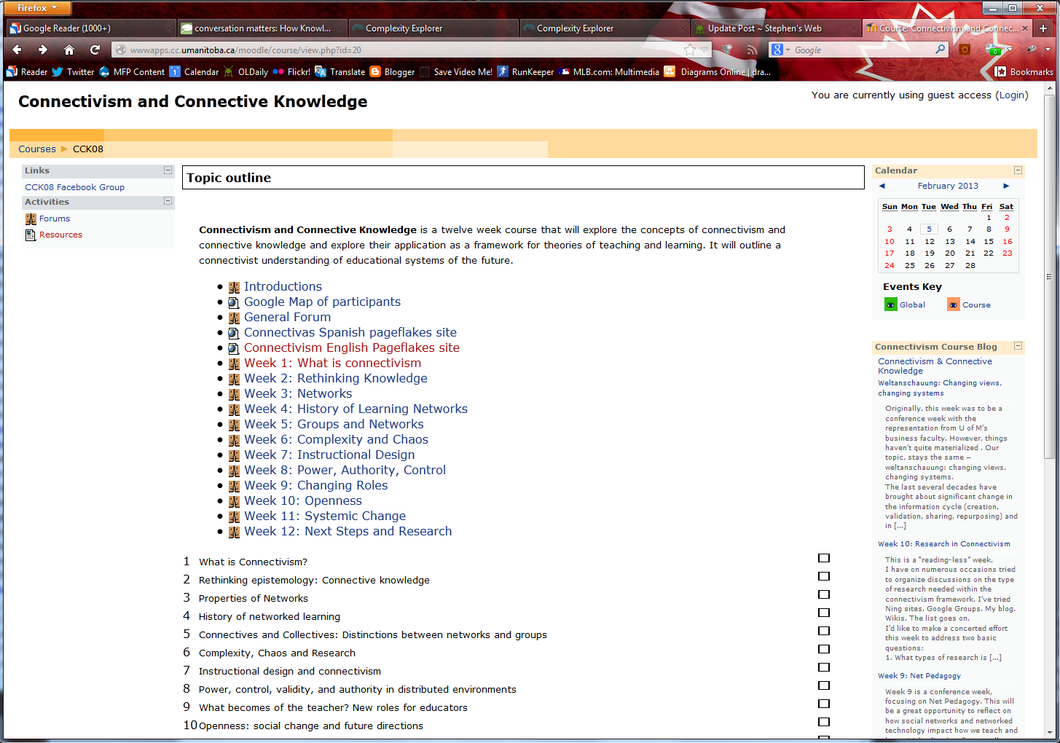
CCK08
2300 students
http://wwwapps.cc.umanitoba.ca/moodle/course/view.php?id=20
http://connect.downes.ca/cgi-bin/archive.cgi?page=thedaily.htm

Slide 5
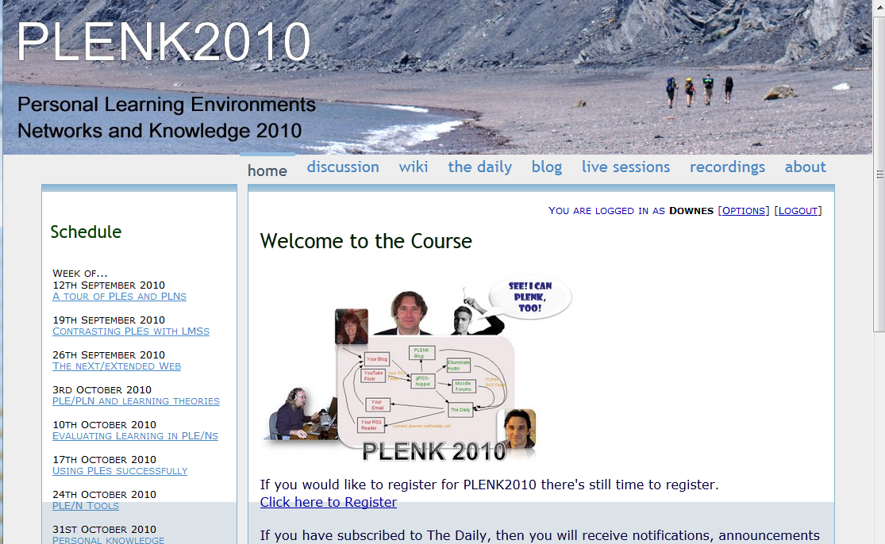
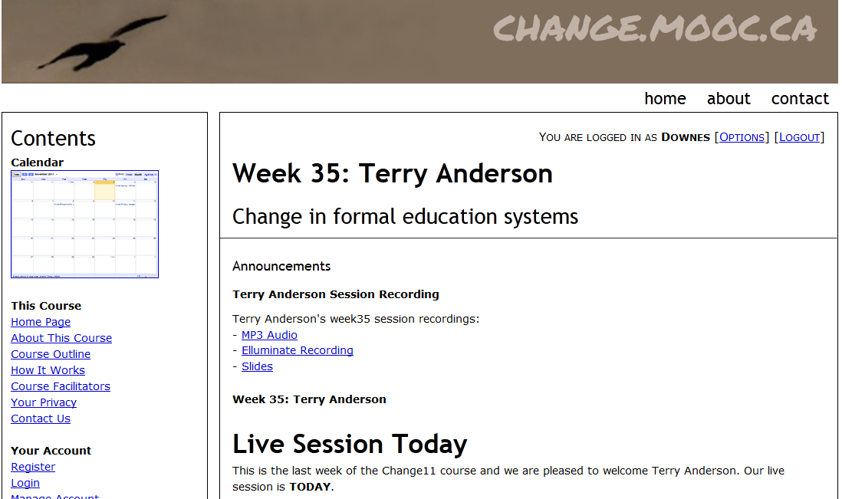
Other Courses
1800 students
http://connect.downes.ca/
2800 students
3000 students
http://change.mooc.ca/
http://edfuture.net/

Slide 6
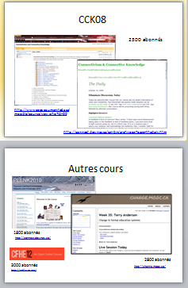
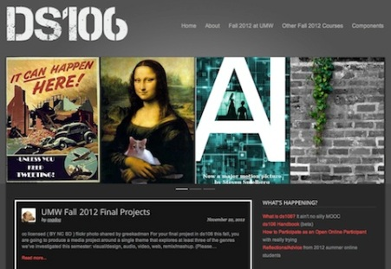
cMOOC vs xMOOC
networks
tasks
contents
https://www.ai-class.com/
http://ds106.us/history/
https://www.coursera.org/
http://lisahistory.net/wordpress/2012/08/three-kinds-of-moocs/

Slide 7
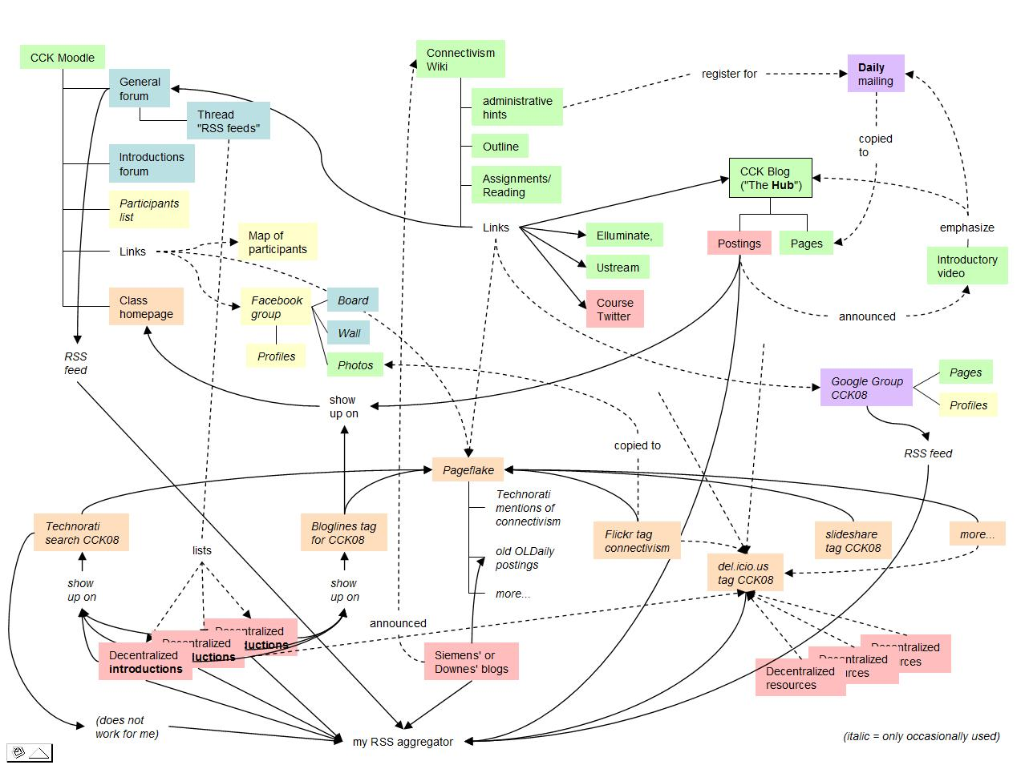
Connectivist MOOCs
http://x28newblog.blog.uni-heidelberg.de/2008/09/06/cck08-first-impressions/

Slide 8
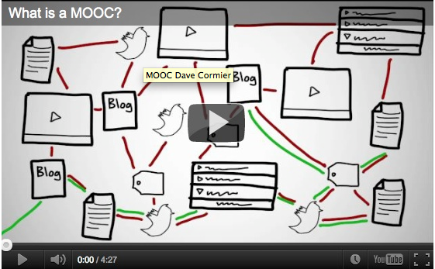
How to Learn in a cMOOC
un processus d'immersion dans une communauté sachant
http://www.tonybates.ca/2012/03/03/more-reflections-on-moocs-and-mitx/

Slide 9
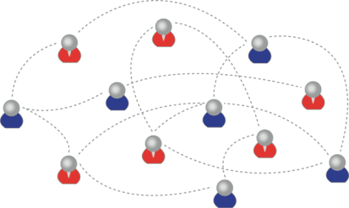
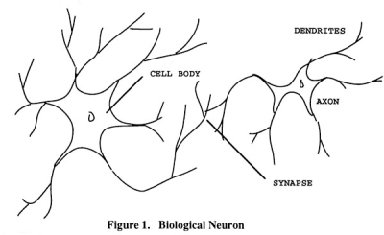
How to Create a cMOOC
It’s like creating a network
Don’t centralize
Concentrate on the creation of links
We use social networks...
… to create personal knowledge

Slide 10
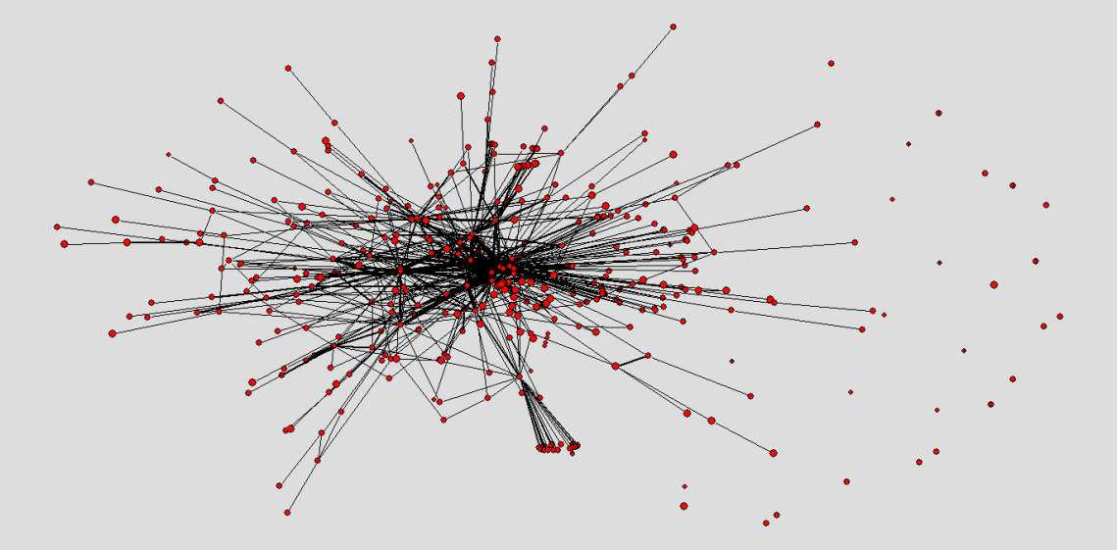
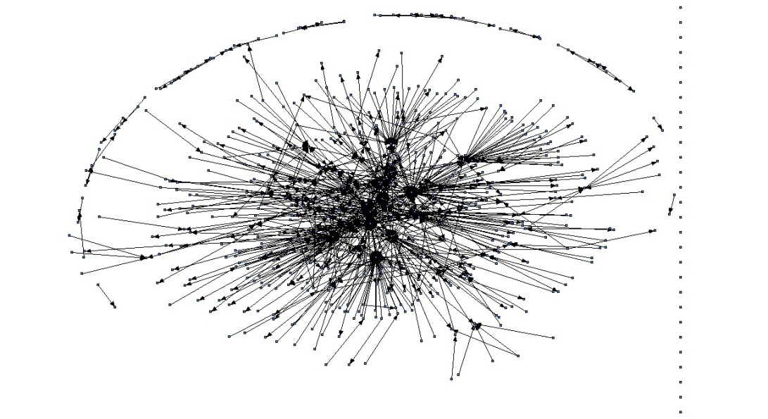
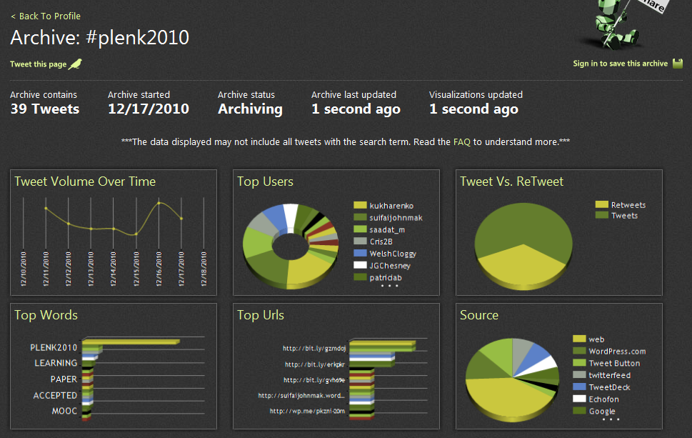
The Semantic Condition
Autonomy, diversity, openness, interactivity
These conditions are the conditions for a constructive dialogue…
And are thus the design principles for a MOOC
http://itforum.coe.uga.edu/paper92/paper92.html

Slide 11
How to Evaluate Leanring
Learning is not possession of a collection of facts, it’s the expression of a capacity
Learning is recognized by a community of experts in a network
analyse d'apprentissage
Nous reconnaissons nos connaissances…
…par comment nous utilisons un réseau social

Slide 12
Why Open Educational Resources?
Learning activities are essentially conversations
OERs are the words used in those conversations
http://www.downes.ca/presentation/233

Slide 13
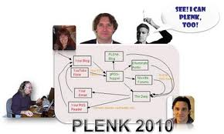
Aggregated Conversations

Slide 14
gRSShopper
http://grsshopper.downes.ca

Slide 15
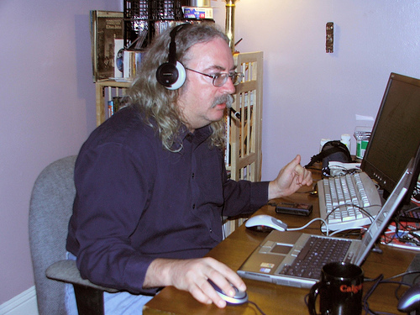
http://www.downes.ca

